Slide 1
Implementation of Yoga Pose Estimation and Feedback Mechanism using Pose Detection for Self Learning
Team Members Panel Number:16
Project Advisor: Dr. K Raghesh Krishnan / Asst. Professor(SG) / CSE
S.No | Reg.No | Name of the Student | Section
1 | CB.EN.U4CSE18112 | DHANUSH V | CSE B
2 | CB.EN.U4CSE18162 | VENKAT R | CSE B
3 | CB.EN.U4CSE18174 | HARSHA VARDHAN D | CSE B
4 | CB.EN.U4CSE18511 | GUHAN K | CSE B

Slide 2
Problem definition
To design a Machine Learning based application that monitors the pose performed by the practitioner and gives real time feedback for improvement of the yoga posture.

Slide 3
Literature Survey
Authors:
Yash Agrawal, Yash Shah, Abhishek Sharma
Full Title with year:
"Implementation of Machine Learning Technique for Identification of Yoga Poses", Communication Systems and Network Technologies (CSNT) 2020 IEEE 9th International Conference on, pp. 40-43, 2020.
Inference from the paper:
Classification of yoga poses based on angles calculated from images using coordinates extracted using tf-pose-estimation ,and Machine Learning Algorithms (Logistic Regression, Random Forest, SVM, Decision Tree, Naive Bayes and KNN) .
Open Problem:
Doesn't provide valuable feedback of how yoga practitioner practices a pose Only Classification of user's pose which does not provide value, Model trained only on datasets of the same person( no diversity in data)

Slide 4
Literature Survey
Authors:
Muhammad Usama Islam, Hasan Mahmud , Faisal Bin Ashraf, Iqbal Hossain and Md. Kamrul Hasan
Full Title with year:
"Yoga posture recognition by detecting human joint points in real time using microsoft kinect", Humanitarian Technology Conference (R10-HTC) 2017 IEEE Region 10, pp. 668-673, 2017.
Inference from the paper:
Estimation of accuracy of the pose through data acquisition with the help of a Kinect device (kinect device can acquire different types of data in data acquisition step such as color, depth and skeleton information ).
Open Problem:
Kinect is an expensive device for Motion sensing , accuracy of the pose doesn’t help the learner to improve / correct his pose .

Slide 5
Literature Survey
Authors:
Deepak Kumar ,Anurag Sinha
Full Title with year:
”Yoga Pose Detection and Classification Using Deep Learning” 2020 International Journal of Scientific Research in Computer Science Engineering and Information Technology ,Volume 6, Issue 6 pp: 160-184 2020
Inference from the paper:
Poses are classified using KNN , SVM , ANN , CNN of the Features extracted from the yoga practitioner using OpenPose.
Open Problem:
Classification model doesn’t give valuable information for the learner to improve /practise yoga.
Model not trained on a diverse dataset.

Slide 6
Literature Survey
Authors:
Sankara Narayanan, Devendra Kumar Misra , Kartik Arora and Harsh Rai
Full Title with year:
“Yoga Pose Detection Using Deep Learning Techniques”” (May 10, 2021) Social Science Research Network (SSRN) http://dx.doi.org/10.2139/ssrn.3842656
Inference from the paper:
Compared the accuracy of classification of 2D and 3D model of OpenPose models by using Convenal Neural Networks and Finally Stated that 3D model of OpenPose Predicts more accurate form results compared to 2D models.
Open Problem:
Inferred that 3D models are more accurate than 2D .yet Classification model doesn’t provide valuable feedback for the learner.

Slide 7
Justification for the proposed problem
Motivation and Need
One of the major problems that Yoga and other exercises face is the correct posture in which they must be performed.
Even a slight error in the posture may nullify the benefits and also lead to structural deformities.
This puts forward the requirement of an instructor who guides on how the exercise must be done in order to get the maximum from the exercise.
In these pandemic days ,where most of us stay/work from home, an application which could supervise and coach the yoga practitioner in real time with best practices will be a great advantage.
This application assists the practitioner by validating wrong postures and provide real time guidance & recommendations like how much they need to stretch their legs, at what degree must their hands, heads be etc. so they gain all benefits from yoga.

Slide 8
Software/Tools Requirements
Flask ( Python library ) - Front End
OpenCV - Used for feature extraction ,object detection in this case the person and altering the orientation and brightness of images.
Media Pipe (coordinates extraction) - Media Pipe offers open source cross-platform, customizable ML solutions for live and streaming media.
Tensorflow – a open source library used for machine learning applications.

Slide 9
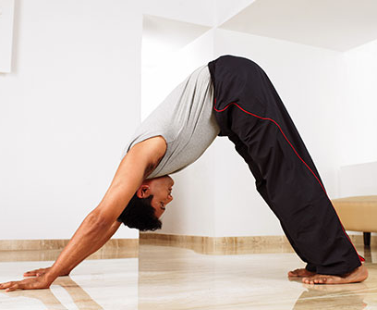
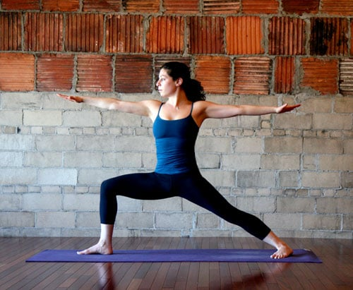
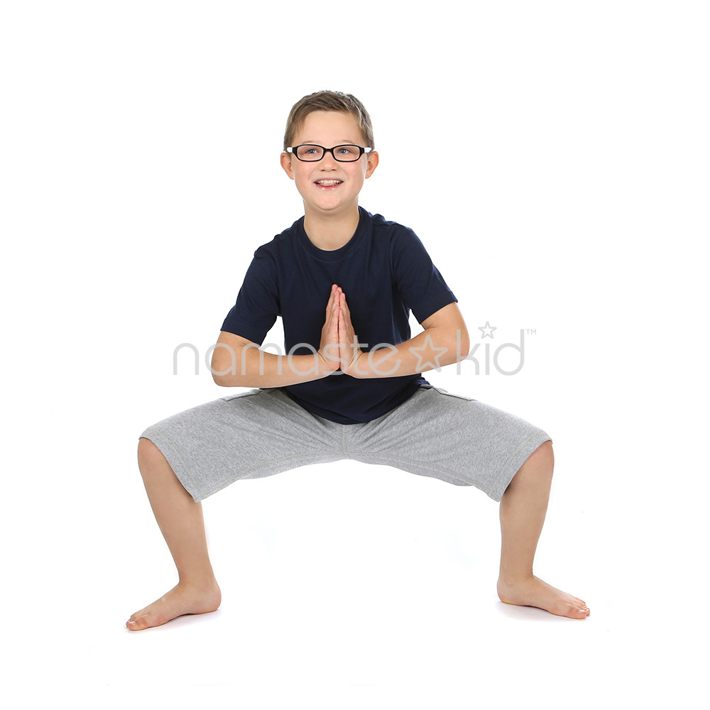
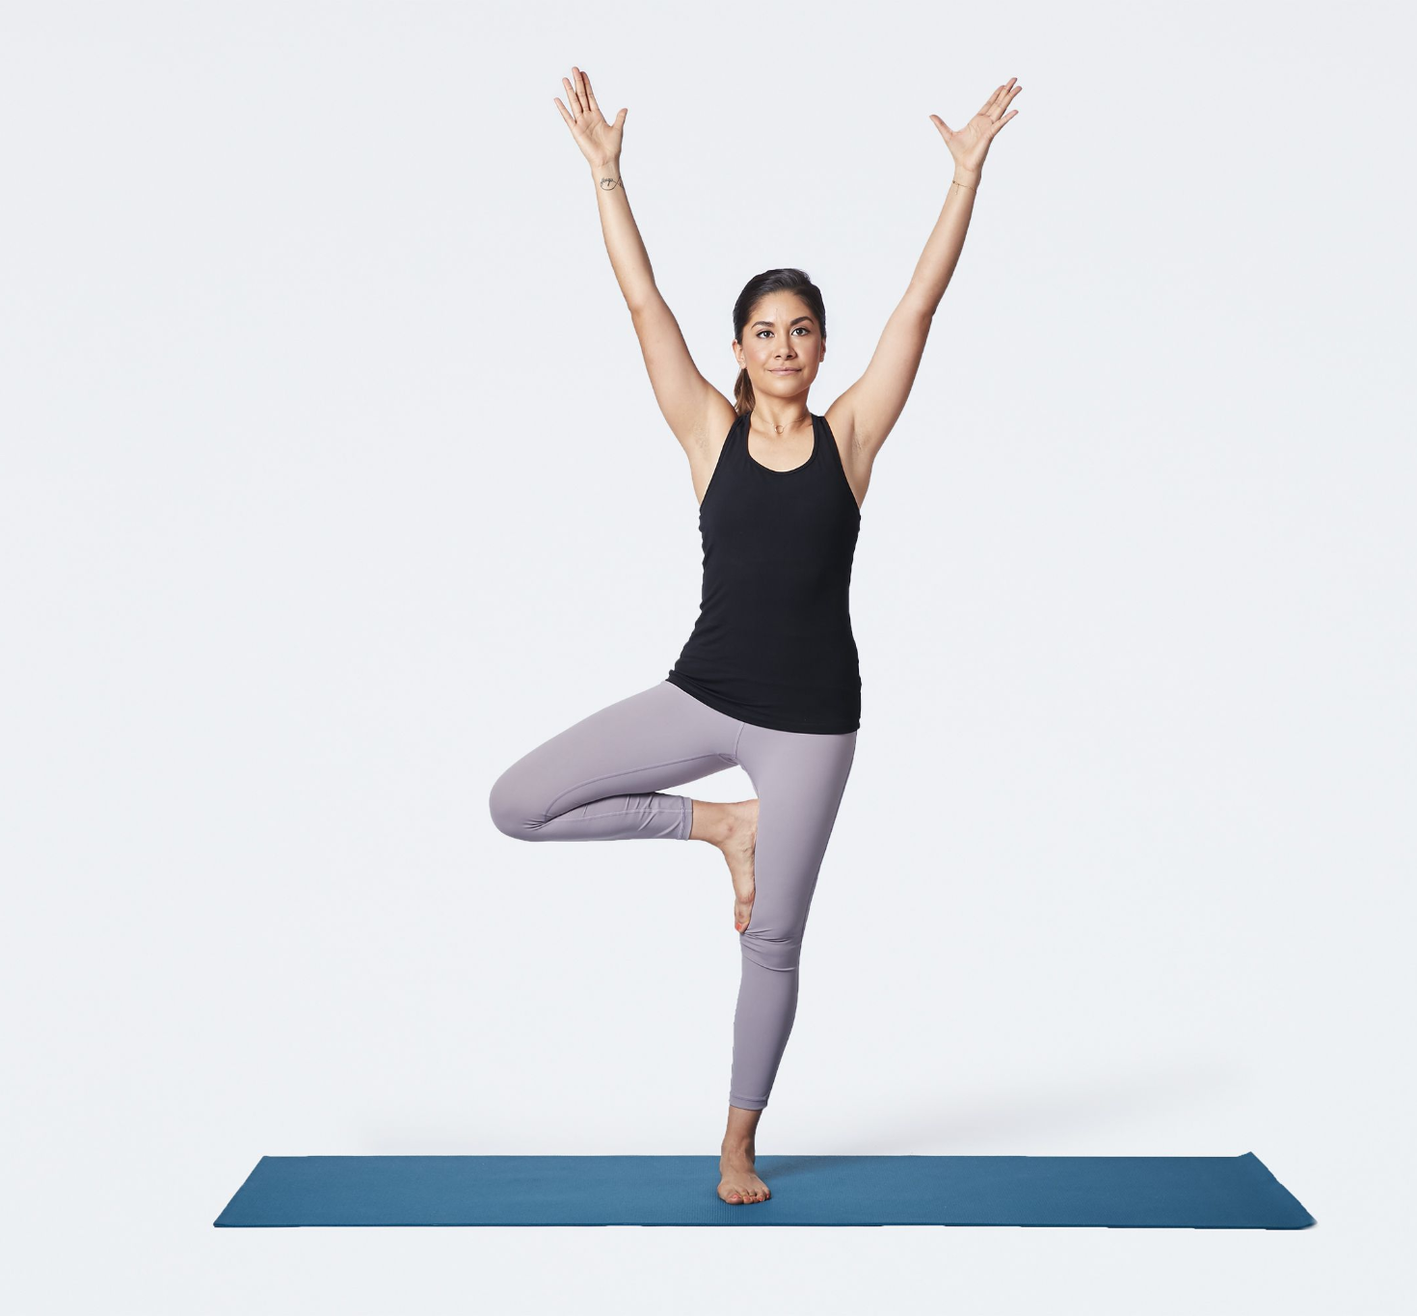
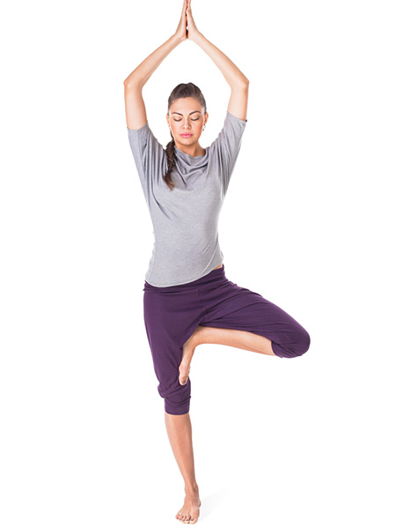
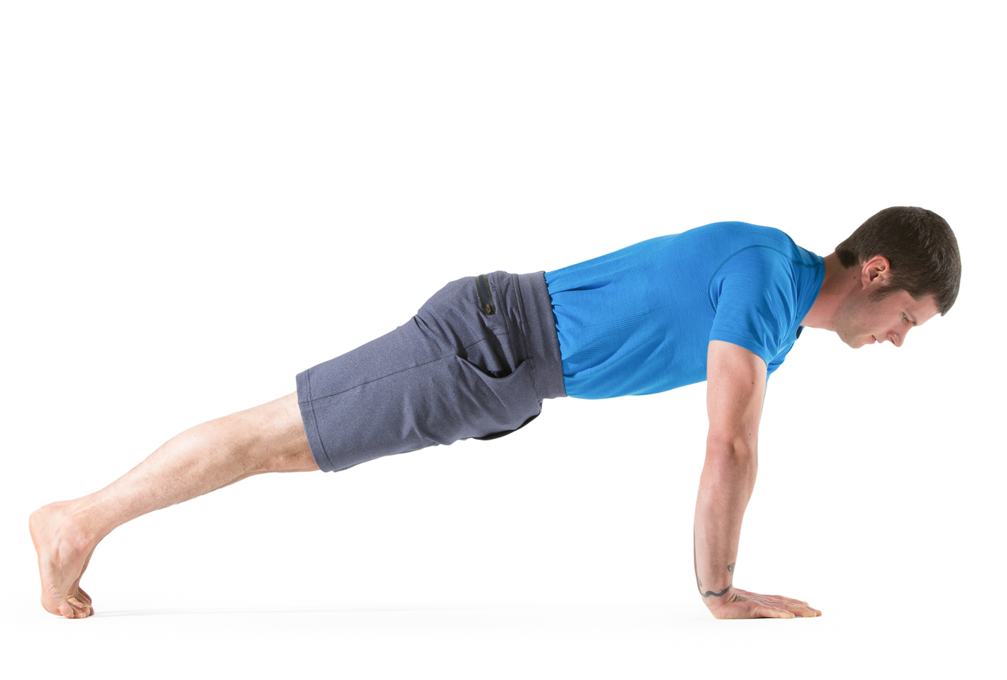
Data Set
Source of data set : https://www.kaggle.com/niharika41298/yoga-poses-dataset
https://sites.google.com/view/yoga-82/home
Sample data set :
downdog warrior goddess Tree Plank
Justification :
The combined dataset contains-
900 + diverse images (Children , Women and Men) for each pose
Images in different Lightings/orientation for each yoga pose .

Slide 10
Work Plan
To create an efficient feedback based Machine Learning Model
To create User-interface for the web-app
To Analyze the existing system
To deploy the application online
Integrate ML Model with the interface

Slide 11
Conclusion
This paper proposes a system for Yoga Pose Training and Feedback System to help the self-learning of Yoga for five different poses. The system assesses a Yoga pose of a learner by detecting the human body first using the webcam, extracting the coordinated points of various joints in the body, calculating the difference of body angles between the trained pose images and that of the user accurately and finally provide real-time feedback on improvisation of the incorrect parts between learner and the trained images.

Slide 12
References
Yash Agrawal, Yash Shah, Abhishek Sharma, "Implementation of Machine Learning Technique for Identification of Yoga Poses", Communication Systems and Network Technologies (CSNT) 2020 IEEE 9th International Conference on, pp. 40-43, 2020. https://ieeexplore.ieee.org/document/9115758
Maybel Chan Thar, Khine Zar Ne Winn, Nobuo Funabiki, "A Proposal of Yoga Pose Assessment Method Using Pose Detection for Self-Learning", Advanced Information Technologies (ICAIT) 2019 International Conference on, pp. 137-142, 2019.http://ieeexplore.ieee.org/document/8920892/
Muhammad Usama Islam, Hasan Mahmud, Faisal Bin Ashraf, Iqbal Hossain, Md. Kamrul Hasan, "Yoga posture recognition by detecting human joint points in real time using microsoft kinect", Humanitarian Technology Conference (R10-HTC) 2017 IEEE Region 10, pp. 668-673, 2017.
https://ieeexplore.ieee.org/document/8289047
Deepak Kumar, Anurag Sinha, ”Yoga Pose Detection and Classification Using Deep Learning” 2020 International Journal of Scientific Research in Computer Science Engineering and Information Technology https://ijsrcseit.com/CSEIT206623
Sankara Narayanan, Devendra Kumar Misra , Kartik Arora and Harsh Rai, “Yoga Pose Detection Using Deep Learning Techniques” 2021 Social Science Research Network (SSRN)
https://papers.ssrn.com/sol3/papers.cfm?abstract_id=3842656

Slide 13
THANK YOU

